Slide 1

Traditional Costume Recognition
Hanbok VS Kimono
AI&Design Ui Jung Yang

Slide 2


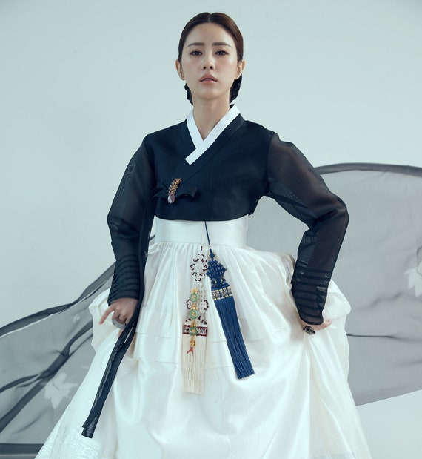
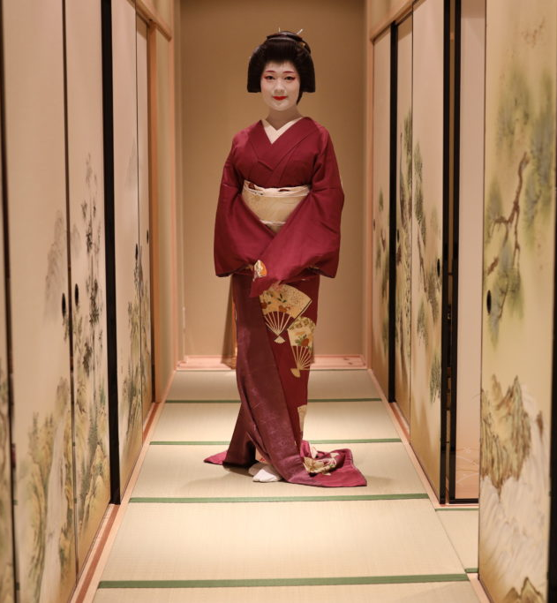
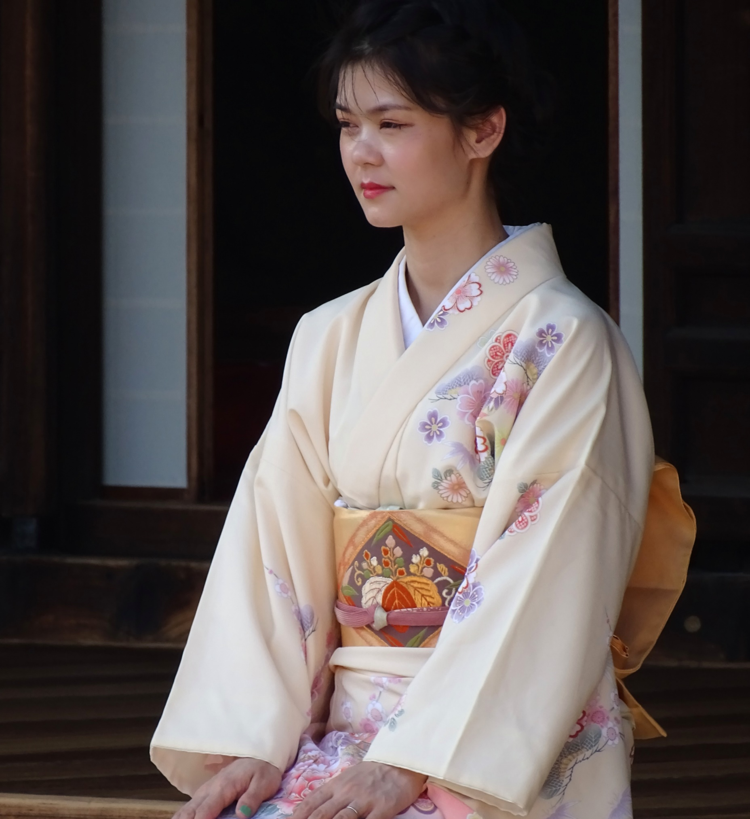
Topic
Korean Costume Hanbok VS Japanese Costume Kimono

Slide 3

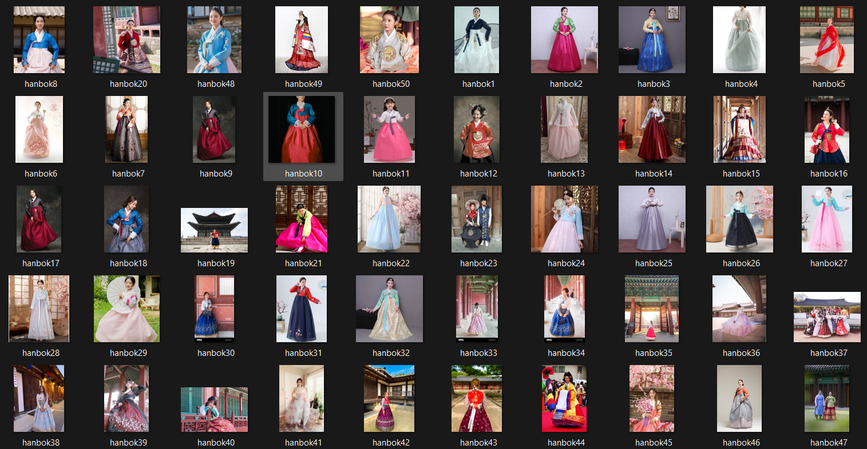
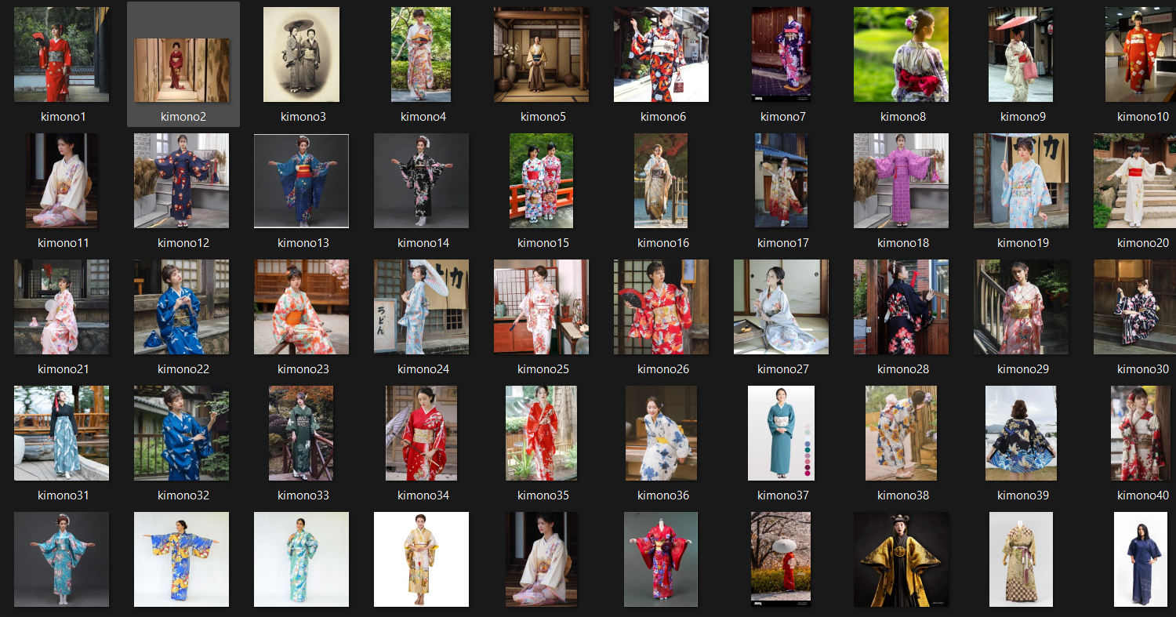
Data Preparation
45 Training images of Hanbok and Kimono

Slide 4
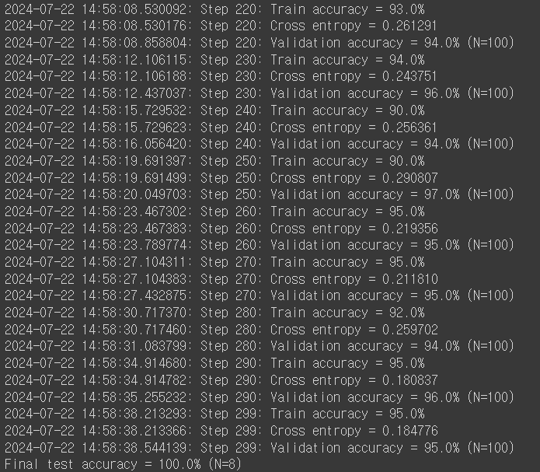
Model Training Result
Train Accuracy : 95.0%
Validation Accuracy : 95.0% (N=100)
Final Test Accuracy: 100.0% (N=8)

Slide 5
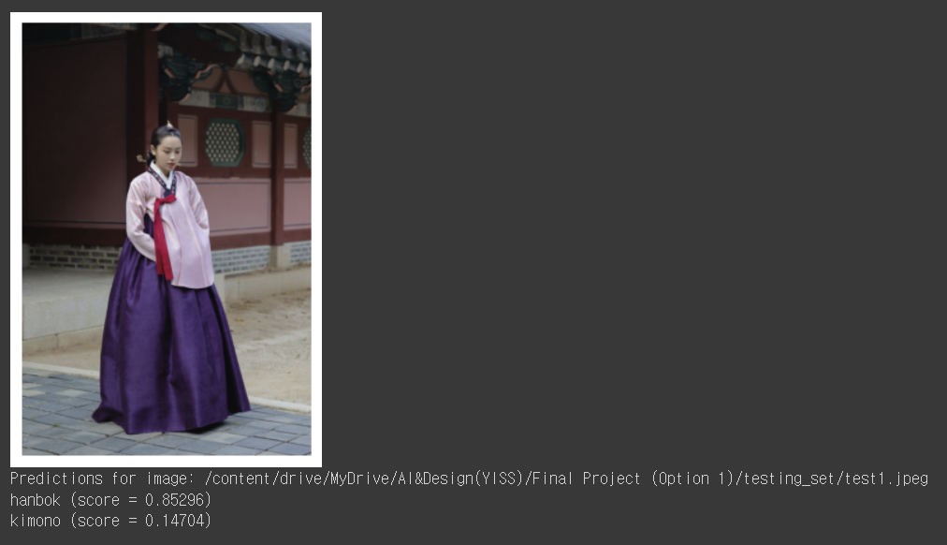
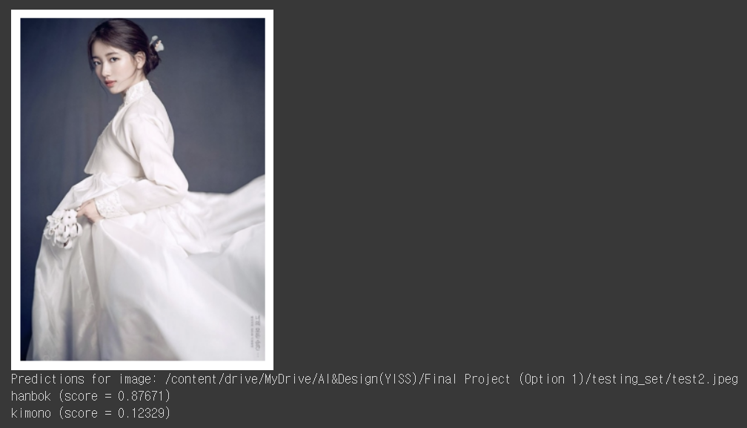
Data Prediction Result- Hanbok

Slide 6
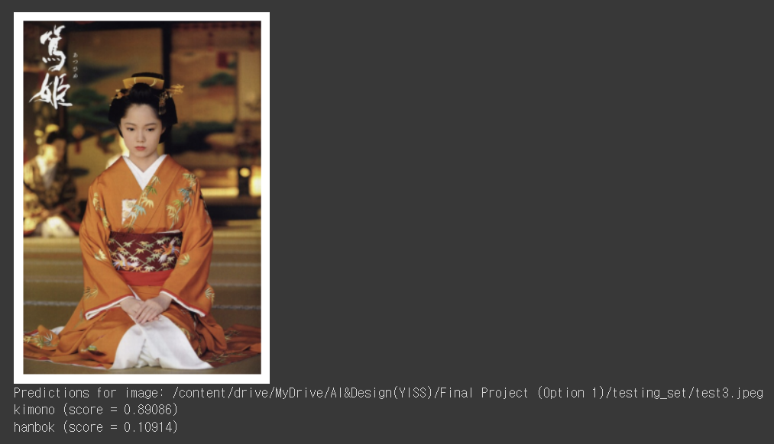
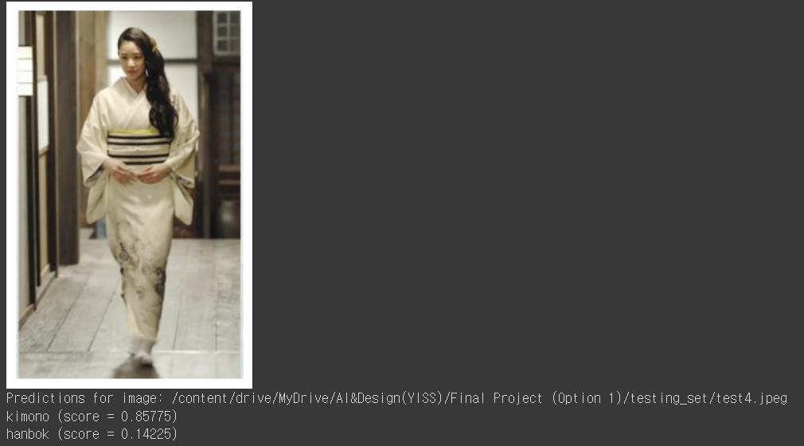
Data Prediction Result-Kimono

